Slide 1
Crop Price Production Prediction Data Science for Agriculture

Slide 2
Agenda
Introduction & Problem Statement
Skills Gained & Tools Used
Project Approach (Our Journey)
Data Understanding & Preparation
Exploratory Data Analysis (EDA) - Key Insights
Model Building & Evaluation (Our "Smart Brain")
Streamlit Application (Our Smart App)
Conclusion & Future Enhancements

Slide 3
Introduction & Problem Statement Agriculture is a key contributor to the economy, and accurately predicting crop production is essential for improving planning and decision-making. This project aims to build a 'smart brain' to predict how much crop will be produced.
Problem Statement
Our core challenge: To accurately predict the total output of a specific crop (in tons) for a given region and year.
Inputs include land used (hectares), crop grown per area (yield), and the year.
Business Use Cases
🍎 Food Planning & Security
📜 Smart Agricultural Policies
🚚 Optimized Supply Chains
📈 Market Price Forecasting
🎯 Precision Farming Guidance
🤖 Agri-Tech Solutions Development

Slide 4
Skills Gained & Tools Used
Skills Gained
Data Cleaning & Preprocessing
Exploratory Data Analysis (EDA)
Data Visualization
Machine Learning (Regression)
Streamlit (Web Applications)
Tools Used
Programming Language: Python
Libraries: Pandas, NumPy, Scikit-learn, Matplotlib, Seaborn
Web Application Framework: Streamlit
Model Persistence: Pickle

Slide 5


Project Approach (Our Journey)
Data Cleaning & Preprocessing: Making Data Ready (from FAOSTAT_data.csv)
Exploratory Data Analysis (EDA): Finding Stories in Data (FAOSTAT_data_cleaned.csv)
Model Building & Evaluation: Building Our "Smart Brain" (Using insights from EDA)
Streamlit Application: Our Smart App (Deploying the "Smart Brain")

Slide 6
Data Understanding & Preparation
Dataset
FAOSTAT_data dataset – a comprehensive source of agricultural statistics.
Key Data Columns
Area: Country/Region
Item: Crop Type
Year: Time
Area harvested: Land used (hectares)
Yield: Crop per area (kg/ha)
Production: Total crop (tons) - Our prediction target!
Data Cleaning & Preprocessing Steps
Removed irrelevant columns (e.g., 'Domain Code', 'Flag’).
Filtered to focus on 'Area harvested', 'Yield', and 'Production’.
Ensured consistent units ('kg/ha' for Yield, 't' for Production).
Handled missing data.
Crucially, pivoted the data: Transformed from a "long" to a "wide" format, creating dedicated columns for 'Area_harvested', 'Yield_kg_ha', and 'Production_tons’.
Result: Cleaned data saved as FAOSTAT_data_cleaned.csv

Slide 7
Exploratory Data Analysis (EDA) - Key Insights
Crop & Geographical Distribution
Identified the most frequent crop types (e.g., Maize, Potatoes) and areas with highest agricultural activity (e.g., China, India).
Visual: Insert the top_15_crop_types_frequency.png and top_15_areas_frequency.png bar plots from your eda_plots folder here.
Temporal Analysis (Yearly Trends)
Observed trends in average 'Area harvested', 'Yield', and 'Production' over time (e.g., Production showing an overall increase).
Visual: Insert the yearly_trends_avg_metrics.png line plot from your eda_plots folder here.
Relationships & Correlations
Found strong positive correlations between 'Area_harvested' and 'Production_tons', and 'Yield_kg_ha' and 'Production_tons’.
This confirms that increasing land use and efficiency directly boost total production.
Visual: Insert the correlation_matrix.png heatmap and/or one impactful scatter plot (e.g., area_harvested_vs_production.png) from your eda_plots folder.
Productivity & Outliers
Compared actual yield with calculated yield to ensure data consistency.
Identified outliers in production/yield, suggesting unusual events (e.g., extreme weather, new policies) or potential data anomalies.
Visual: (Optional: Small version of outliers_boxplots.png if space allows, or just mention the finding).

Slide 8

EDA PLOTS

Slide 9
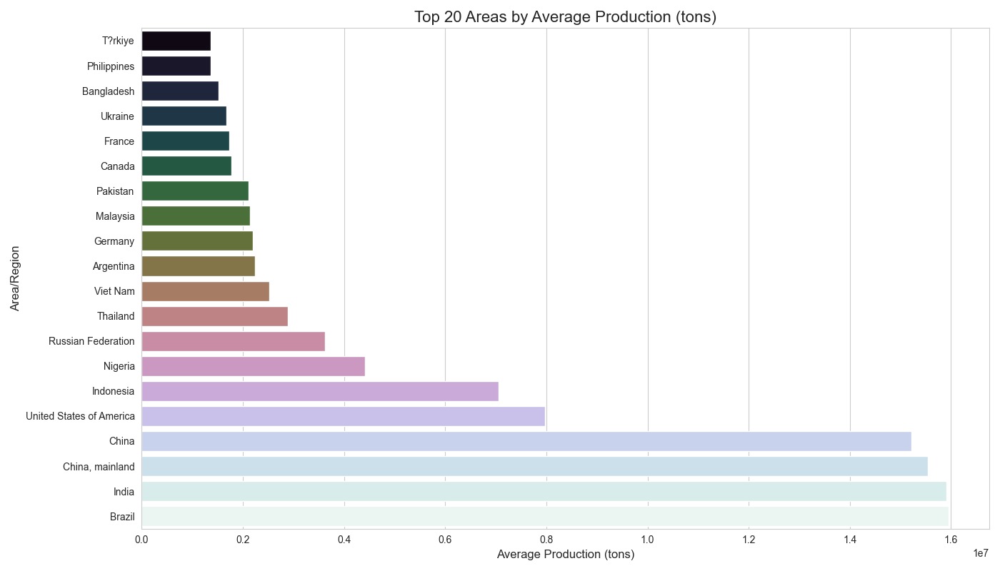

Slide 10
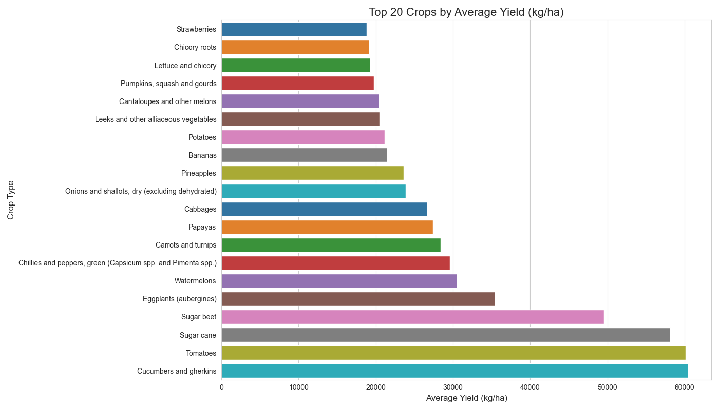

Slide 11
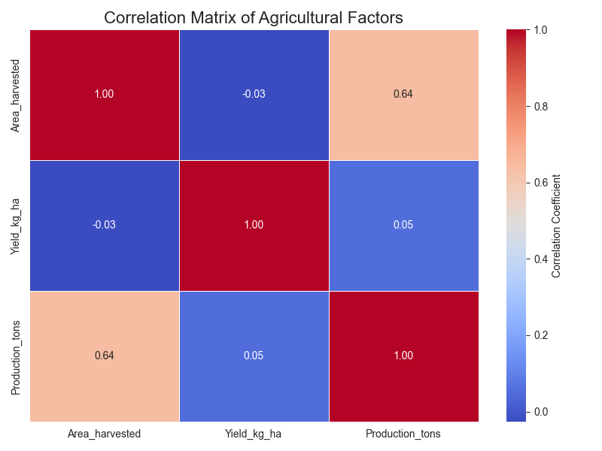

Slide 12
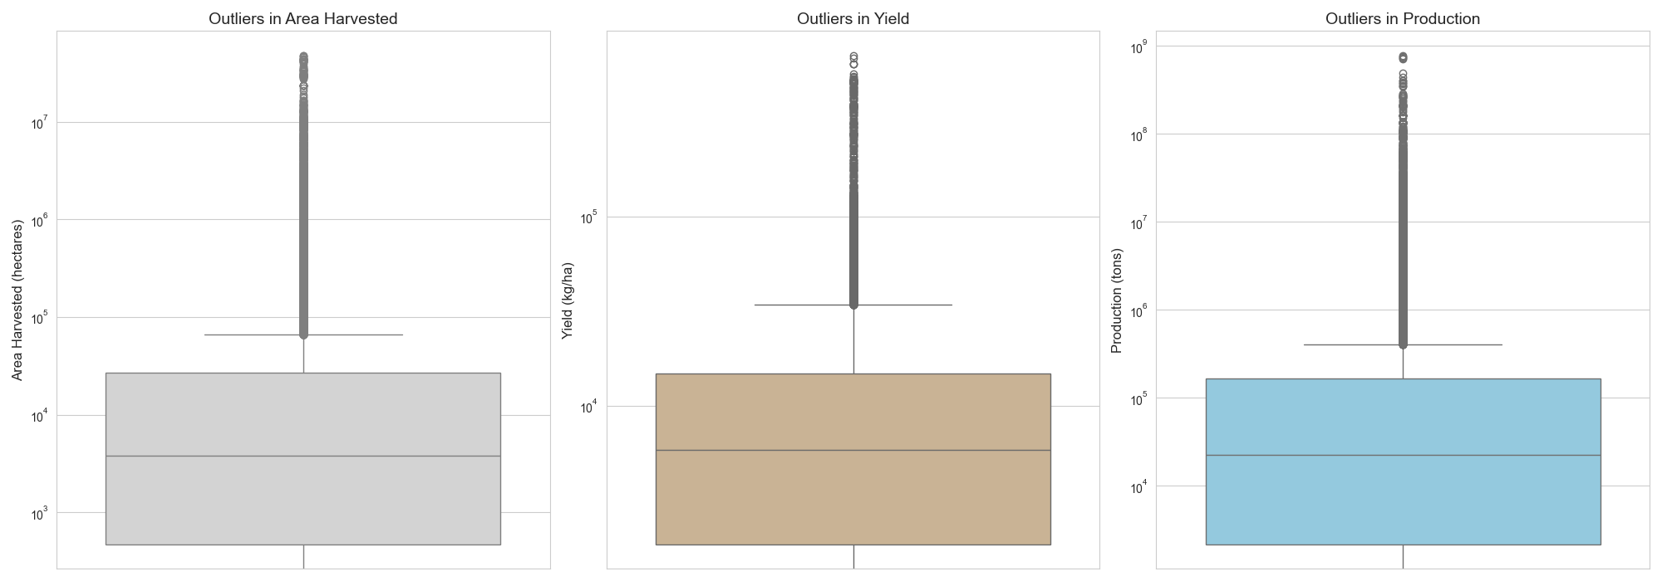

Slide 13
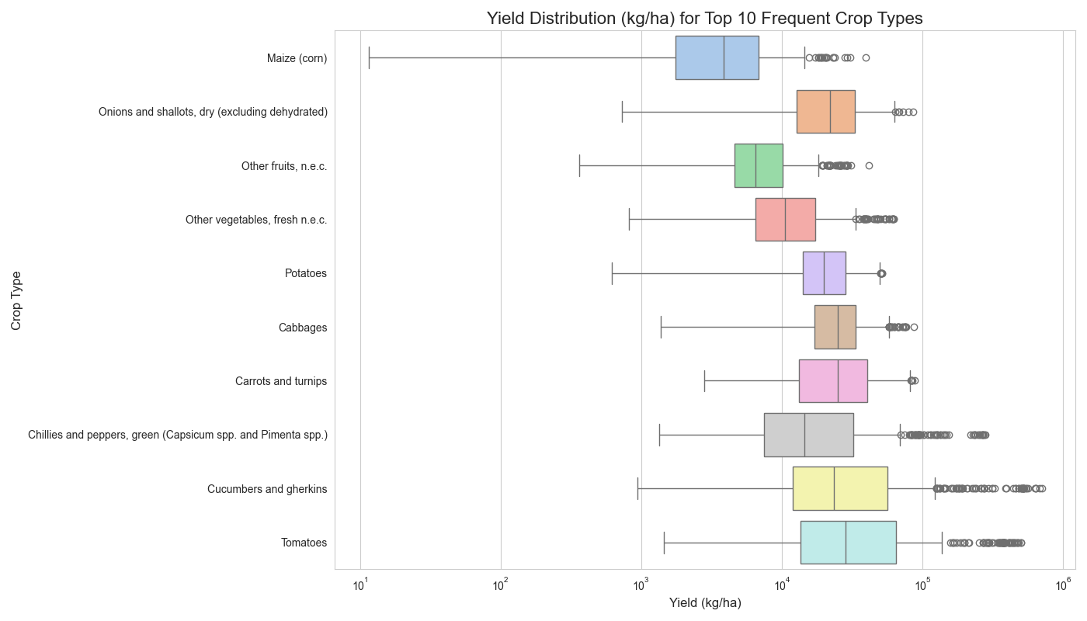

Slide 14
Model Building & Evaluation
Goal: To accurately predict 'Production_tons’.
Features Used (Inputs)
Area, Item, Year, Area_harvested (hectares) and Yield_kg_ha (kg/ha)
Modeling Approach
Data was split into Training (80%) and Testing (20%).
Used a Smart Pipeline to prepare data (scaling numbers, encoding categories).
Models Evaluated: Linear Regression, Decision Tree, Random Forest, Gradient Boosting.
Model Performance
Linear Regression: Low Accuracy
Tree-based Models (Decision Tree, Random Forest, Gradient Boosting): Highly Accurate!
Best Model Selected
The Random Forest Regressor was chosen as the champion!
Achieved R2 of 0.9947 (explains over 99% of variations in production!) and a low prediction error.
Saved as best_crop_production_model.pkl for our app.

Slide 15
Streamlit Application
Purpose:
A user-friendly tool for anyone to easily estimate crop production.
Functionality
Easy Inputs: Select Area, Crop Type, Year; enter Area Harvested & Yield.
Instant Prediction: Get an estimated production in tons!
Historical Context: View past data, trends, and statistics for your selected Area & Crop Type.
How to Run
streamlit run streamlit_app.py

Slide 16
Streamlit App

Slide 17
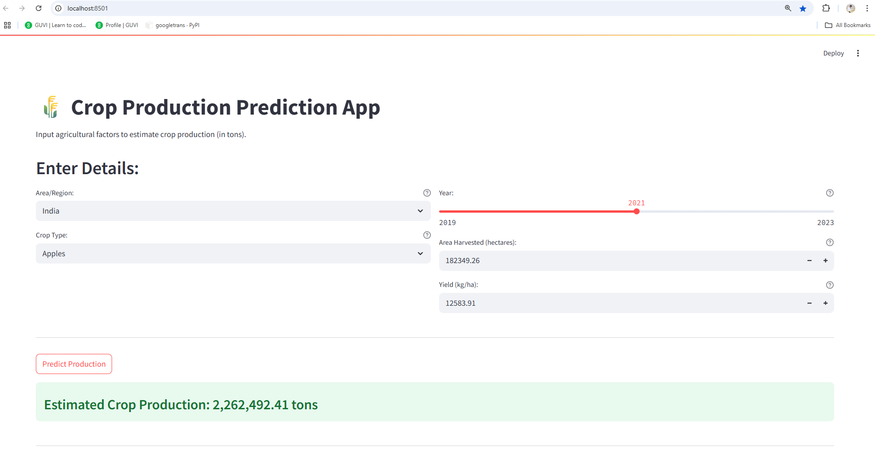

Slide 18
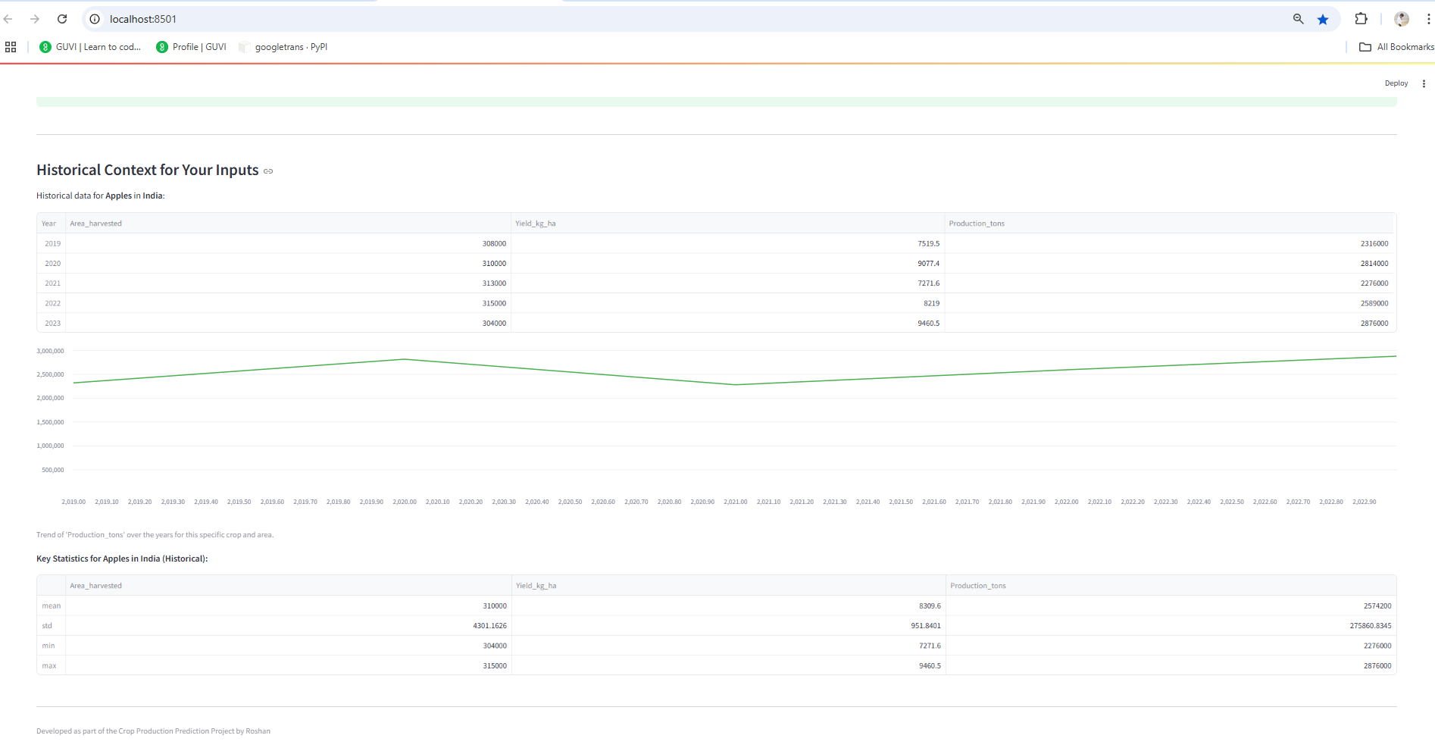

Slide 19
Conclusion & Future Enhancements
Conclusion
Successfully built a robust tool to predict crop production.
Through data cleaning, in-depth analysis, and smart modeling, we uncovered valuable insights.
Our interactive Streamlit app makes forecasting accessible, supporting data-driven agriculture.
Future Enhancements
Incorporate more data: weather patterns, soil types, economic factors.
Explore advanced time series models for future trend prediction.
Add features for comparing different scenarios directly in the app.
Deploy the app on a cloud platform for wider accessibility.

Slide 20
Thank you
Roshan A
7708847635
roshana36822@gmail.com

